Slide 1
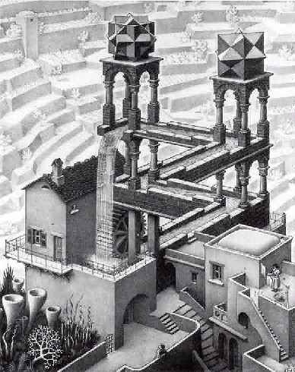
Energy: No Such Thing as a Free Lunch
Eric Prebys

Slide 2
Motivation for This Lecture
The basic facts:
The energy consumption of the human race is increasing.
Soon, the developing world will pass the US and Western Europe in energy usage.
Our reliance on fossil fuels is impacting our environment, perhaps catastrophically.
Fossil fuels will run out – maybe in 10 years, maybe in 100, but they will run out.
The current emphasis on “going green” has raised the stakes for alternative energy sources:
Scientifically, this is very exciting, but…
It will also not be lost on the con men.

Slide 3

Is this lecture necessary?
Unfortunately, Homer’s conceptual understanding is well above average!

Slide 4
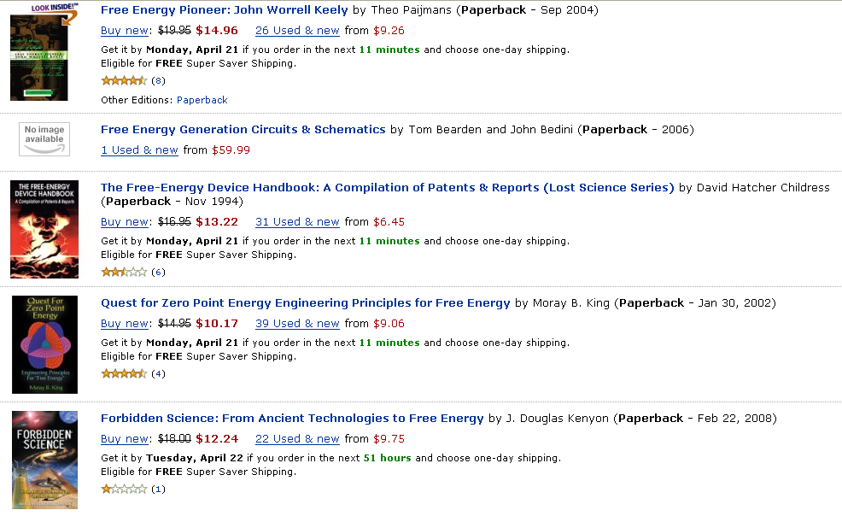
Evidence: Amazon search "free energy"
Top 5:

Slide 5
Working definition: How free is "free"?
For the purposes of this discussion, “free energy” refers to transformative technologies that:
Can be implemented on an individual basis
i.e. non-centralized
Will enable dramatic reduction in domestic and/or transportation energy expenses
say, a factor of four or more
Do not require a lifestyle change
Involve only modest capital costs
Pay for themselves in less than a year or so
Some examples which do NOT qualify:
Trading in your Hummer for a motorcycle
Lifestyle change
Converting your home to 100% solar
Takes several years to recover the cost

Slide 6
Types of “free energy”
Perpetual Motion: A device which produces useable output energy with no input energy or fuel.
To the extent science declares anything “impossible”, this is impossible.
Dramatically improved efficiency in utilizing an existing power source.
A legitimate idea, but there limits
A new source of energy or radically different way of tapping and established source of energy
Examples: cold fusion, zero-point energy, hydrinos, etc.
In many cases, claims of the second two types really imply the first

Slide 7
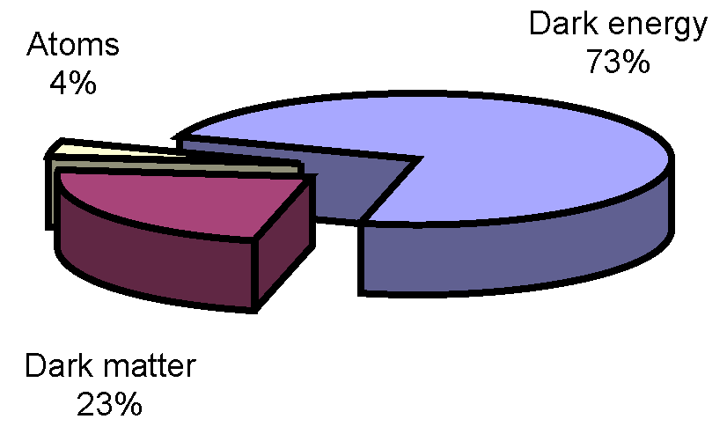
How can we be so sure or ourselves?
After all, we only know what 4% of the universe is made of.
Can’t there be some sort of energy source in the other 96%?
Maybe, but even if we don’t know what 96% is, we know a lot about what it isn’t.

Slide 8
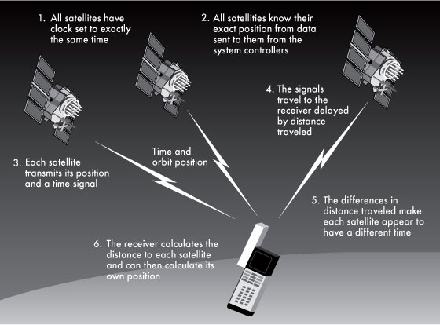
Consider the GPS
For a GPS to work, we have to understand
The chemistry of the fuel
The dynamics of the launch and orbit
The physics of the onboard atomic clocks
The E&M involved in generating and transmitting the signal
The Special and General Relativity corrections required
38 μsec = 11.4 km/day error without them!
And then there’s all the physics needed to put that much computing in your hand.
None of this would work if unknown particles and forces interacted significantly with ordinary matter.

Slide 9


Early perpetual motion machines
Some of the oldest perpetual motion machines were documented by the Indian author Bhaskara (c. 1159), who made sketches of something called the “Persian Wheel”
This device used flowing water (or sand) to create a “perpetual imbalance”
Still find people claiming to build these on FaceBook

Slide 10
Perpetual motion and physics
We need to examine these early claims in the context of the time.
Because there was no theoretical framework to rule out these machines, these people were behaving as good scientists.
The fact they didn't work was an important piece of experimental evidence.
All of this changed with Newton
F=ma and the “universal law of gravitation” held the mathematical key to ruling out all of these “imbalance” type perpetual motion machines in one fell swoop.

Slide 11
Physics and energy
In the 18th and 19th centuries, a great deal of physics was done to formalize the concepts of work, energy, and conservation laws.
The non-observation of perpetual motion was taken as input to these theories.
The 19th century saw the development of thermodynamics
Term originally coined by James Joule to describe the science of heat and power
Generalized to cover all physical systems
Lays out the specifics of the relationship between physical systems and usable energy
As new types of physics were discovered, the still fit into this paradigm
Electricity and Magnetism
Relativity
Nuclear energy
Quantum Mechanics

Slide 12
First Law of Thermodynamics
Every system is characterized by an energy (U)
This law is also known as “Conservation of Energy”
Change in energy
“Heat” put into system
Work done by system

Slide 13
Second Law of Thermodynamics
Not all energy is useable!!
Every system is characterized by an “entropy” (S)
A measure of energy and degree of order
Generally “Low entropy” = high energy and high order
The entropy of a “closed” system can never decrease.
Can only get work out of system in a transition to a higher entropy state. (S₂>S₁)

Slide 14

Second Law and Heat
Entropy increases as heat flows from high to low temperature
We can extract work when heat flows from high temperature to low temperature
We have to do work to move heat from low temperature to high temperature.

Slide 15
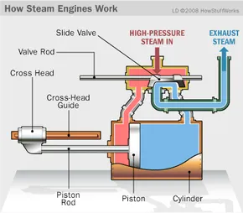
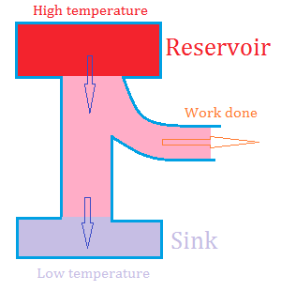
2nd law: getting energy out…
Steam engine:
A source of heat makes stream
The steam pushes a piston, cooling in the process.
The steam is then exhausted to a cooler reservoir

Slide 16
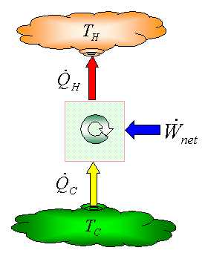
2nd Law: doing work to move heat
Air conditioning
This is why you can’t use your refrigerator to cool your house!
Work is done to move heat from inside the house to the radiator unit outside the house.
The heat radiated outside the house is equal to the heat removed from the house plus the work it took to move it.

Slide 17
The Bottom Line
To date, no violation of the Laws of Thermodynamics has ever been observed
Period.
Exclamation point!
Red box around it

Slide 18
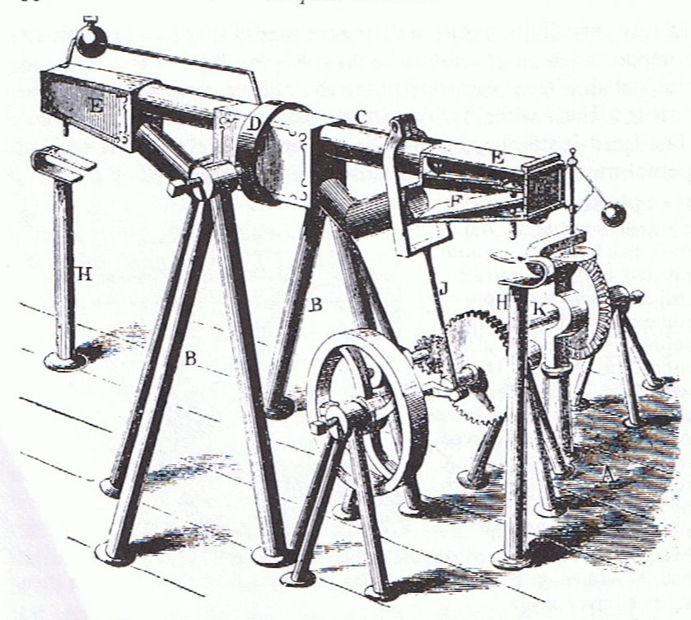
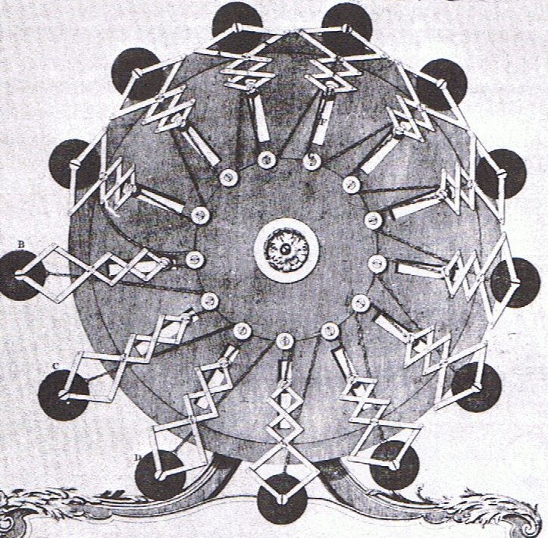
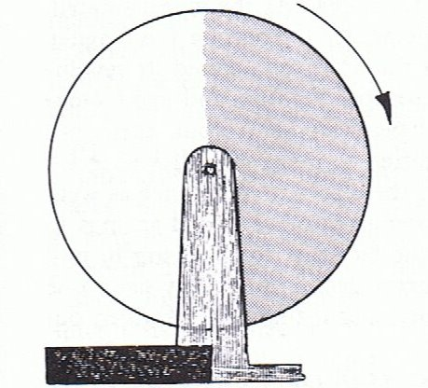
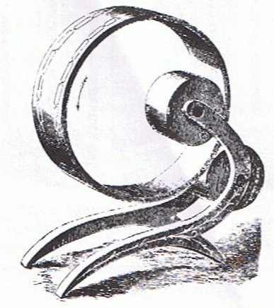
Interest continued, undaunted by facts*
Gravitational imbalance…
*Illustrations taken from A.W.J.G Ord-Hume, “Perpetual Motion: The History of an Obsession”
Gravitational shield!

Slide 19
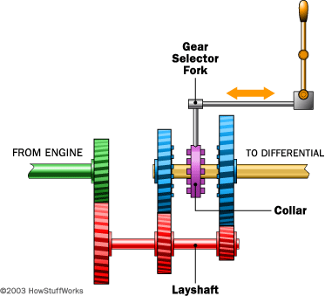
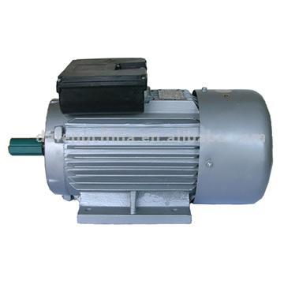
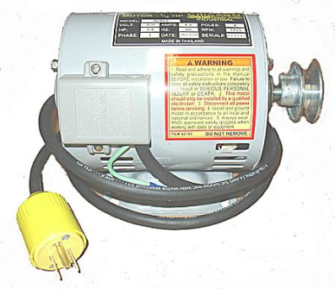
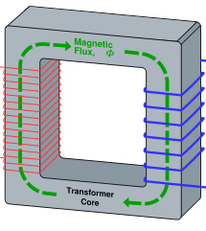

Perpetual Motion 101 (electricity example)
Start with a motor…
which turns a generator…
which powers the motor…
with perhaps some left over!
Doesn’t work??
Try adding some gears…
or maybe a transformer
etc, etc, etc…

Slide 20
Redefining the problem
Instead of talking about “perpetual motion”, talk about “over-unity”; that is, gearboxes, transformers, etc, in which the power out is greater than the power in
Physically, P_{out}≤P_{in} - ALWAYS
“Over-unity” = “perpetual motion” - PERIOD
torque
current
angular frequency
voltage

Slide 21
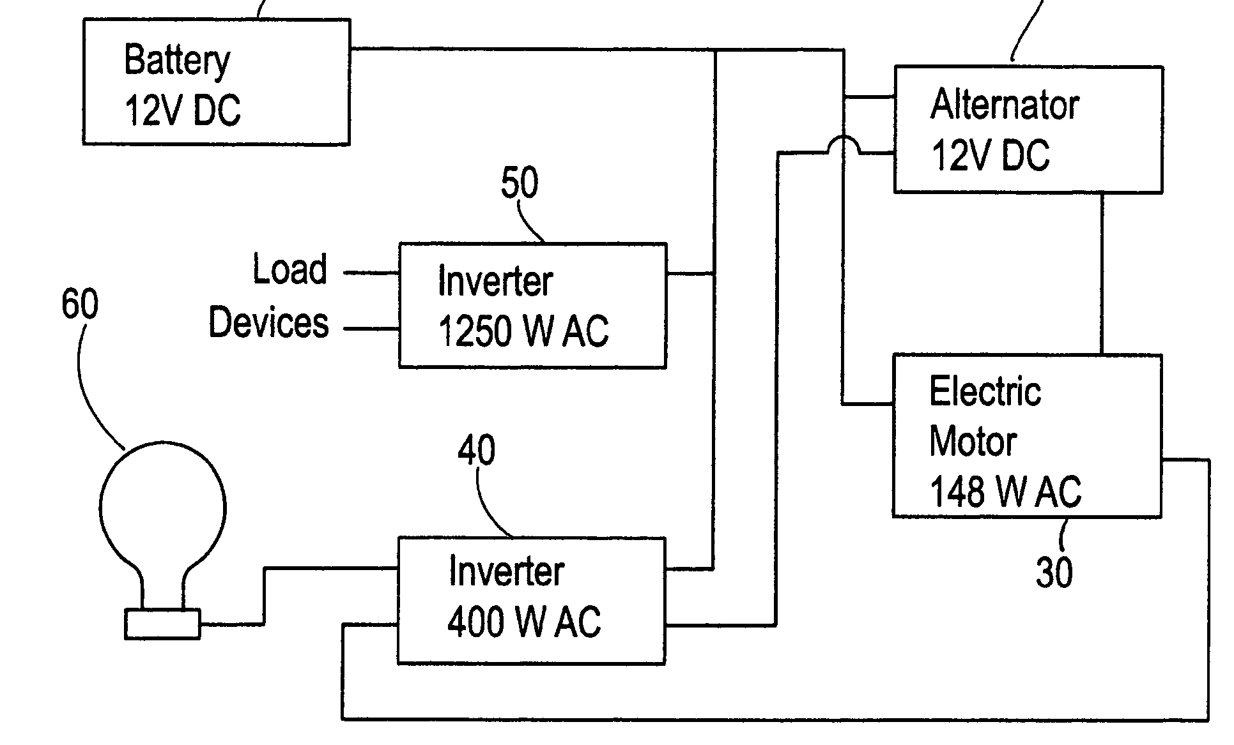
In case you thought my example was silly
US Patent #7,095,126: ”Internal Energy Generating Power Source” (2006)
ABSTRACT
An external power source such as a battery is used to initially supply power to start an alternator and generator. Once the system has started it is not necessary for the battery to supply power to the system. The battery can then be disconnected. The alternator and electric motor work in combination to generator (sic) electrical power.

Slide 22
Speaking of patents
A partial list of US patents purported to support perpetual motion:
2,006,676: “Electrolytic Carburetor” (Garrett Carburetor)
Launched a whole kook industry
4,074,153: “Magnetic propulsion device”
4,151,431: “Permanent magnet motor”
4,215,330: “Permanent magnet propulsion system”
6,246,561: “Methods for controlling the path of magnet flux…”
6,362,718: “Motionless electromagnetic generator”
6,523,646: “Spring driven apparatus”
6,526,925: “Piston driven rotary engine”
6,962,052: “Energy generation mechanism, device and system”
7,095,126: “Internal energy generating power source”
The one we just talked about

Slide 23
Patents and perpetual motion
The Patent Office has had so much trouble with perpetual motion machine patents that it’s developed special rules.:
“With the exception of cases involving perpetual motion, a model is not ordinarily required by the Office to demonstrate the operability of a device. If operability of a device is questioned, the applicant must establish it to the satisfaction of the examiner”
- 35 U.S.C 101 (Examiners’ Handbook)
Translation: “If the Patent Office didn’t ask for a working model, they didn’t believe it was a perpetual motion machine”.

Slide 24
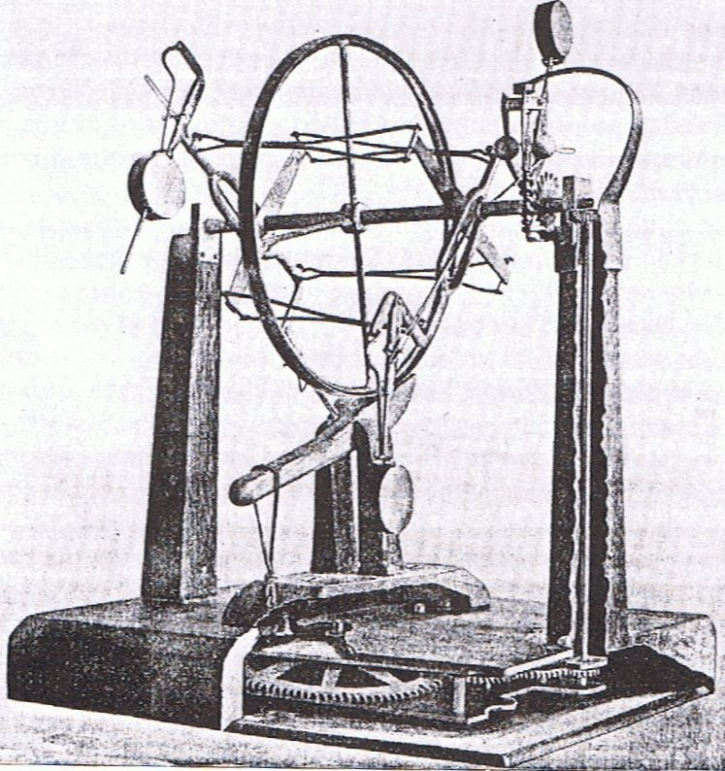
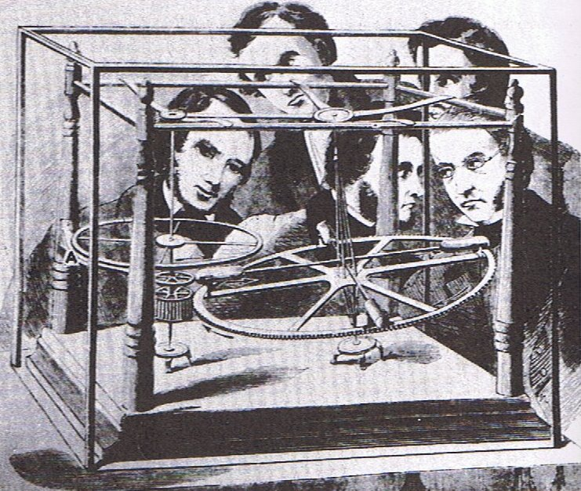
Early frauds
Perpetual motion was mostly an intellectual curiosity, until the Industrial Revolution convinced people of its “value”
J.M. Aldrich’s machine ran on hidden springs (1899)
E.P. Willis’ “overbalanced wheel” ran on hidden compressed air. (1850’s)

Slide 25
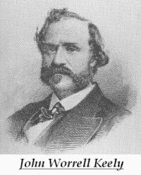
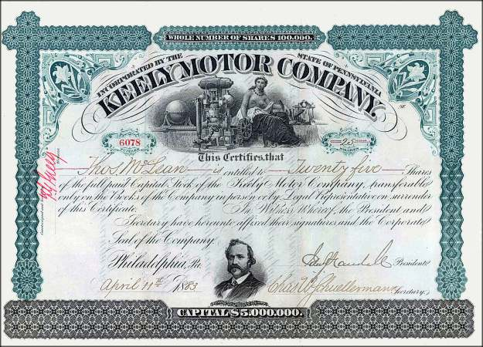
John Keely: the father of the free energy scam
There were numerous perpetual motion frauds in the 19th century, but most were pretty small scale
In 1872, John E. Worrel Keely claimed to have discovered a new type of motor, which used some sort of musical resonance to extract energy from the “luminiferous ether”.
He formed the “Keely Motor Company”, began giving public demonstrations and selling stock.

Slide 26
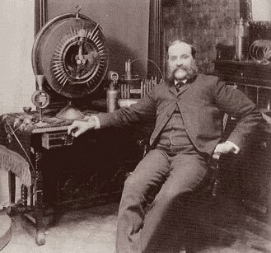
Keely and his times
In the context of the times, Keely’s claims were not all that unbelievable:
This was before Special Relativity, and “Luminiferous Ether” was the hypothetical fluid through which electromagnetic waves, including light, propagated.
This was the golden age of empirical physics, and finding a way to extract energy from this medium was not yet experimentally ruled out.
Keely’s behavior, on other hand, should have raised some alarm bells
He never published any data regarding the mode of operation of his machine in scientific journals.
He never allowed any independent test or even inspection of his machine.

Slide 27
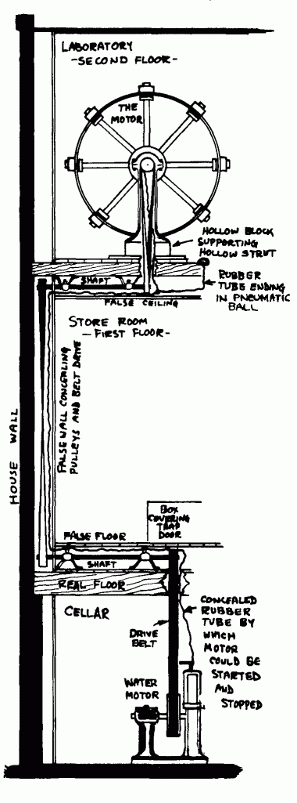
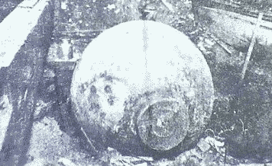
Keely: postmortem
“Scientific American” had always been skeptical of Keely. Following his death, they inspected his home.
They discovered an elaborate system of pipes and hoses, connected to his machines through hollowed out legs on the furniture!
The entire system was powered by a compressed air tank in the basement.

Slide 28
Major classes of modern free energy devices
Motors that run on permanent magnets
Usually find excuses to connect them to batteries
“Over-unity” transformers that put out more electrical power than they take in.
Rather than admit they are selling a perpetual motion machine, they will usually claim to be tapping the “Zero Point Energy” (ZPE)
Engines that run on water
Generally deny being “perpetual motion machines”
Instead claim to split water into H and O with “very high efficiency”
Fancy jars of goo
Cold fusion
Self-charging batteries
Yet more ZPE devices

Slide 29
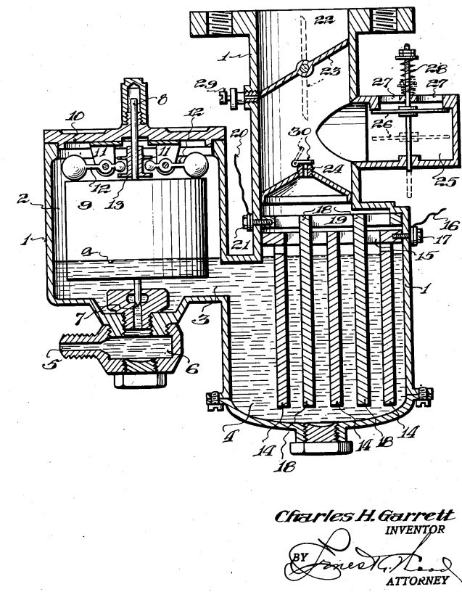
Motors that run on water
Tapping the energy of water is to the “free energy community” what the Philosopher's Stone was to alchemists.
Even Keely himself claimed to have a motor which ran on water in 1890.
A patent was issued in 1935 for the “Garrett Carburetor”, which set the standard for countless water schemes to follow. The principle is quite simple:
Invent an “efficient” way to use electricity to separate water into Hydrogen and Oxygen.
Burn the Hydrogen.
Use a small amount of the energy to generate electricity to produce more Hydrogen.

Slide 30
The problem
Burning Hydrogen and Oxygen produces water.
Remember the First Law of Thermodynamics
An engine that runs on water
Starts with water
Ends with water (i.e. in the same state)
Extracts useable energy
Cars that run on water violate the laws of physics as we know them

Slide 31
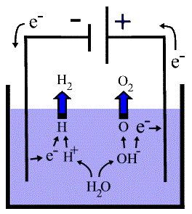
Electrolysis: in the real world
Electrolysis is the process by which electricity is used to break water into Hydrogen and Oxygen
Energy is released when the Hydrogen and Oxygen are recombined , which again produces water
The energy released in recombining the Hydrogen and Oxygen is always less than the energy used in electrolysis.

Slide 32
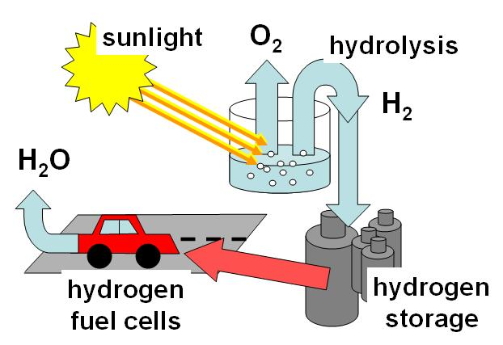
Application of Hydrogen cycle
Hydrogen can be used to store energy from inherently intermittent sources like wind and solar
Lots of practical problems to solve, but no problem with the laws of physics

Slide 33
A Few Examples of Energy from Water Claims
Stanley Meyer
Claimed to have a dune buggy that ran on water in the 1980s.
Never let anyone inspect it.
Patented everything before his death in 1986, but no one can make it work.
Dennis Klein
In 2002, developed “Aquygen”, which he claimed could extract energy from water.
Started me on this obsession.
I’ve moved this to my “Media” lecture, because they were very complicit.
Genesis World Energy
Major investment scam started in 2002.
Promised cars and home generators running on only water.
The owner, Patrick Kelly, was sentenced to five years in jail in 2006.

Slide 34
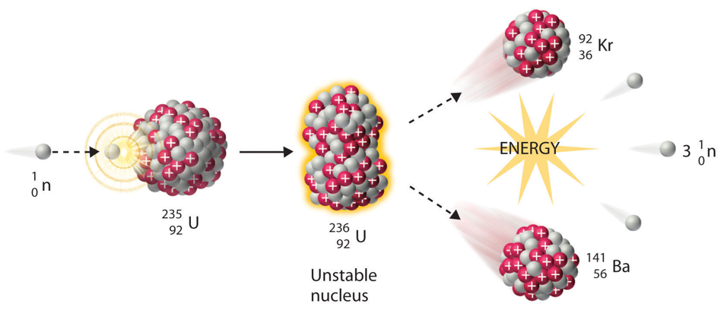
Digression: Nuclear Fission
All existing nuclear plants extract energy from nuclear fission; that is, breaking about heavy nuclei in a chain reaction.

Slide 35
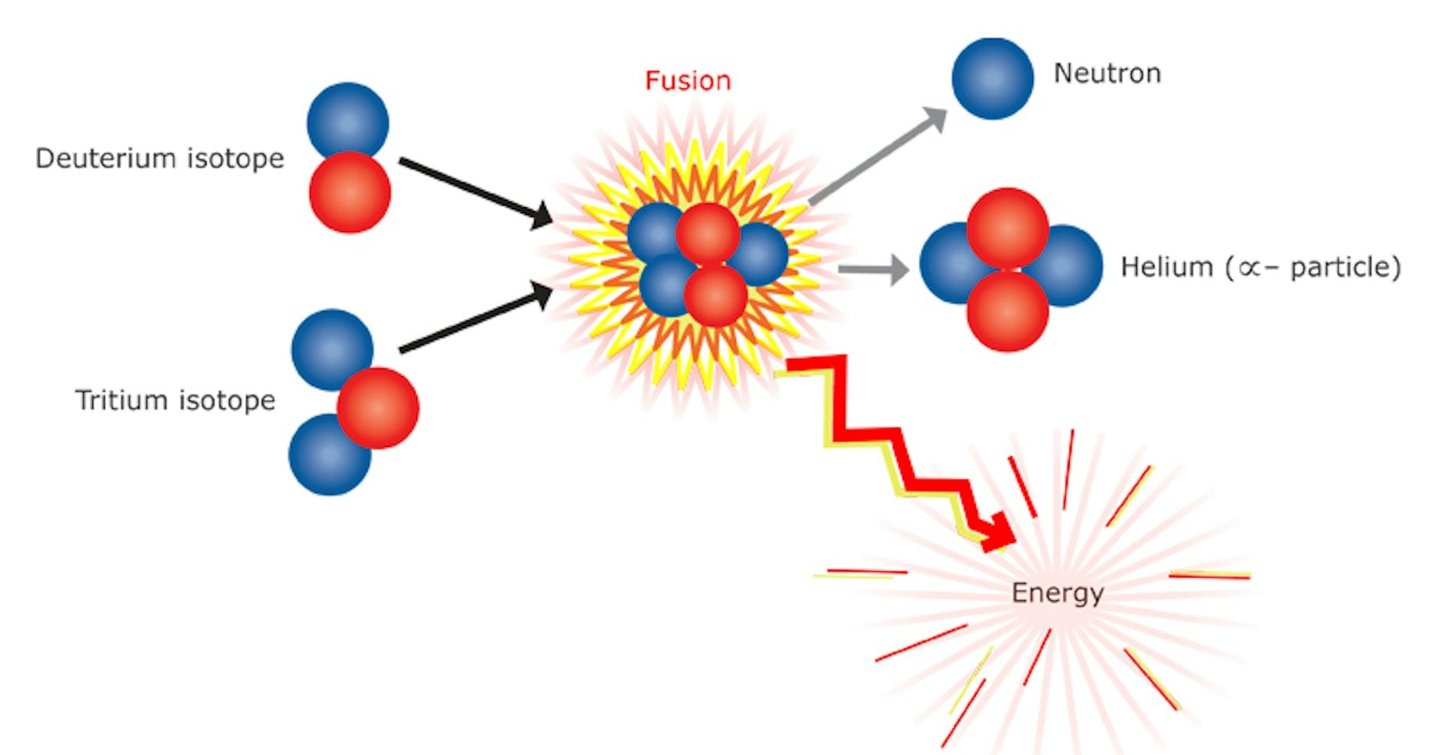
Nuclear Fusion
We could in principle get more and cleaner energy energy by fusing lighter nuclei
Unfortunately, it’s very hard to do this.
We had a fission reactor before we had a fission bomb.
We’ve had nuclear fusion (thermonuclear) bombs for over 70 years, but we’re still not even close to a reactor.

Slide 36
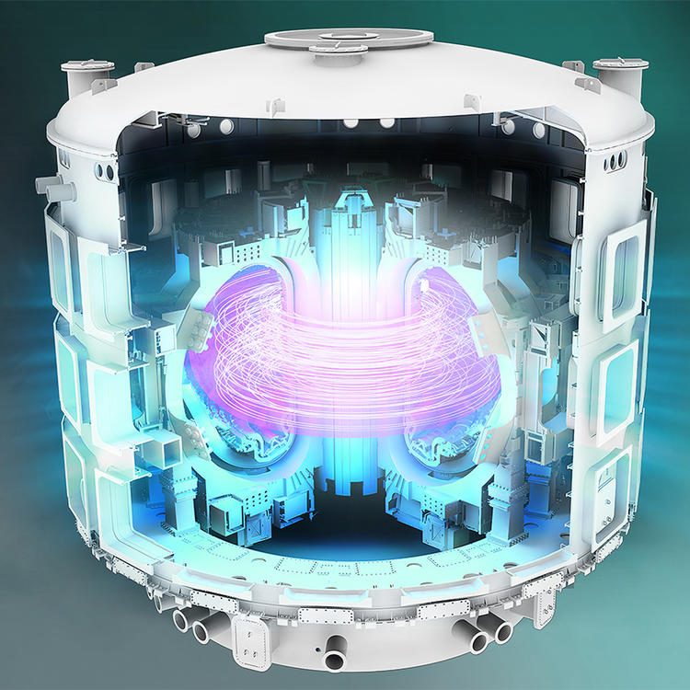
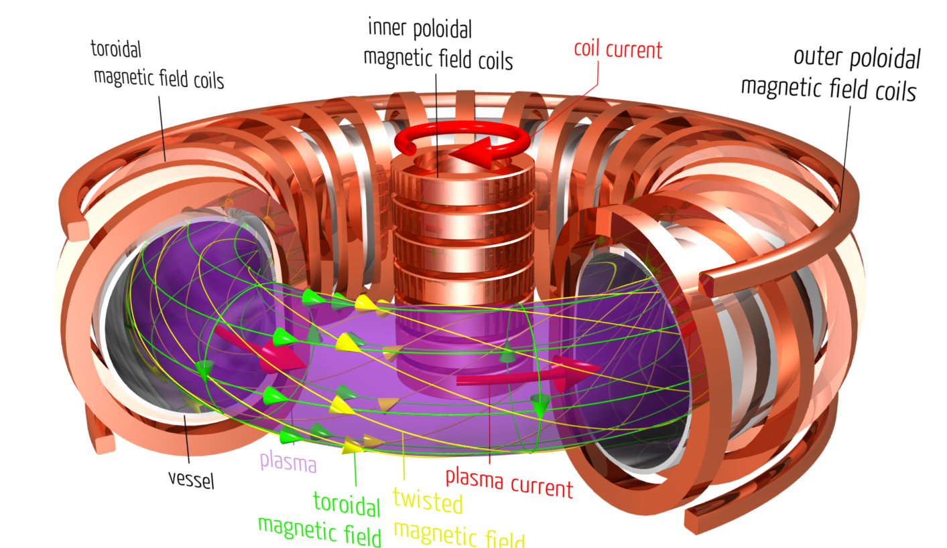
Magnetic Confinement Fusion
Use magnetic fields to keep particles together long enough to fuse
Example: ITER in France
Planning started in 1978
Construction started in 2007
Scheduled to demonstrate sustained fusion in 2039 (!!)
Demonstration machine only. Not a power reactor.

Slide 37
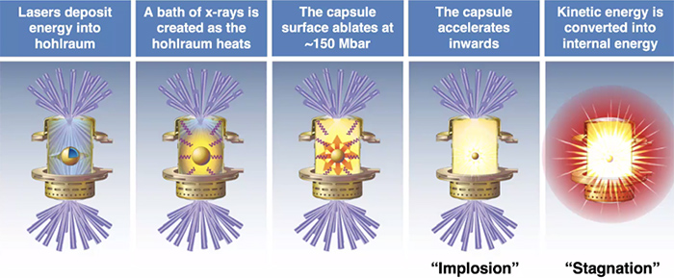
Inertial Confinement Fusion
Compress nuclei with powerful lasers.
Fusion happens before they can fly apart.
Most successful facility is the National Ignition Facility at Lawrence Livermore National Lab.
192 HUGE lasers
Some recent successes, but no clear path to a power plant
But what if there were an easier way…

Slide 38
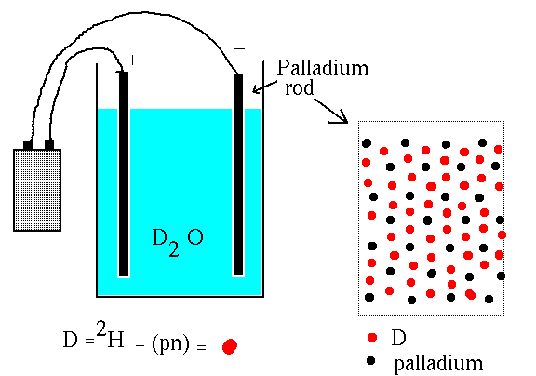
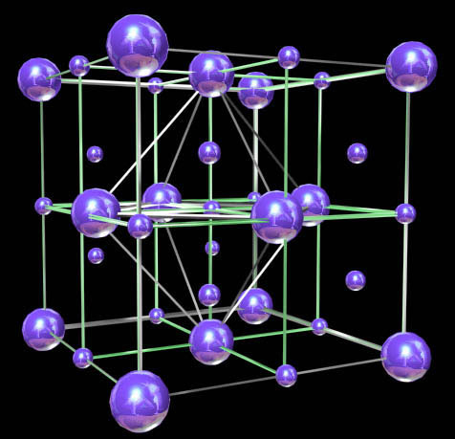
Cold fusion: the revolution that wasn't
In 1989, two teams announced they had seen evidence for nuclear fusion at room temperature taking place in a Palladium rod which had been loaded with Deuterium from heavy water.
One team, Pons and Fleischmann, claimed energy release at a level which promised practical application.
The other, Rafelski and Jones, claimed much less energy and didn’t make as much news.
Although difficult to reconcile with solid state physics, there’s nothing a priori impossible about the claim, and theorists struggle to accommodate the result.

Slide 39

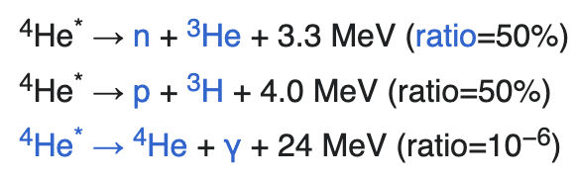
Problems Right Out of the Gate
These are hard measurements, because palladium is very reactive
Ordinary D-D fusion occurs through the reaction
But the helium is excited and decays to
P & F claimed they say 4000 neutrons/second, BUT
Their clamed excess heat of 1 Watt should have produced 10¹² neutrons/second
Which would have been lethal!
Should see neutrons
Should see helium and gamma rays

Slide 40
The road from fallacy to fraud
By the 1989 APS meeting in Baltimore, many groups had tried to replicated the results, and no one had succeeded.
They added a huge evening session, attended by the press
Nathan Lewis, a chemist at Cal Tech, offered an explanation for all of their results in terms of sloppy experimental techniques:
Pons and Fleischmann did not attend, as they were busy soliciting funds.
In addition, obvious cross-checks were not done
Control test with ordinary water
Assay for Helium, the product of fusion
Cold fusion was dead – scientifically anyway.

Slide 41

And yet…
Cold fusion is alive and well in the minds of believers
There are magazines, websites, books, products, and conferences.
Still makes the news ~once/year
“60 Minutes” episode even did an episode on it.

Slide 42
What Became of Pons and Fleischman?
They continued to solicit funding to do “research”, finally settling into a lavish “lab” in France.
They moved to a lavish “lab” in France, funded by a subsidiary of Toyota.
They kept claiming positive results, but never published anything convincing.
Eventually:
Fleischman retired to England, continuing to believe
Died in 2012 from complications from Parkinson’s Disease
Pons stayed in France, stopped doing research, and probably accepted the obvious.
I recommend the documentary: “The Believers” (2012):
Available on Tubi and elsewhere

Slide 43
Cold Fusion Research Today
There are still a handful of people doing “serious research” in the cold fusion.
Even they admit that the vast majority of “researchers” are kooks and conmen
They occasionally claim to see positive results, but they are not at all consistent with each other (very important)
They’ve split into two groups:
Groups that claim to see the expected neutrons and therefore claim it’s ordinary D-D fusion
Groups that don’t see neutrons and claim it’s some sort of new “Low Energy Nuclear Reaction” (LENR)
These groups are very good at debunking each other!
None of them claim anything like the energy excesses Pons and Fleischman claimed.

Slide 44
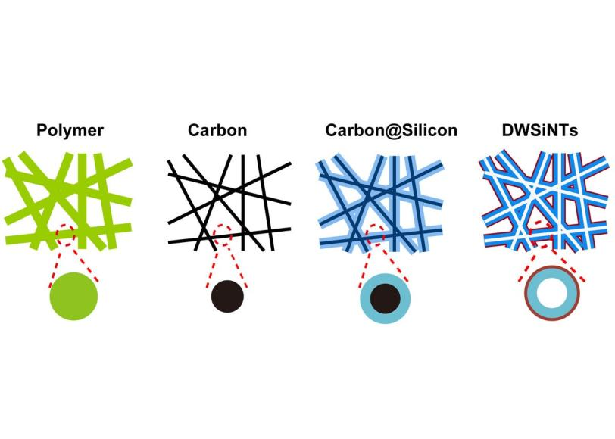
Hope for the Future
Solar and Wind?
“Free”, but intermittent
The science is in finding ways to store the energy
Hydrogen economy
Pumping water uphill
Compressed gas
Better batteries

Slide 45
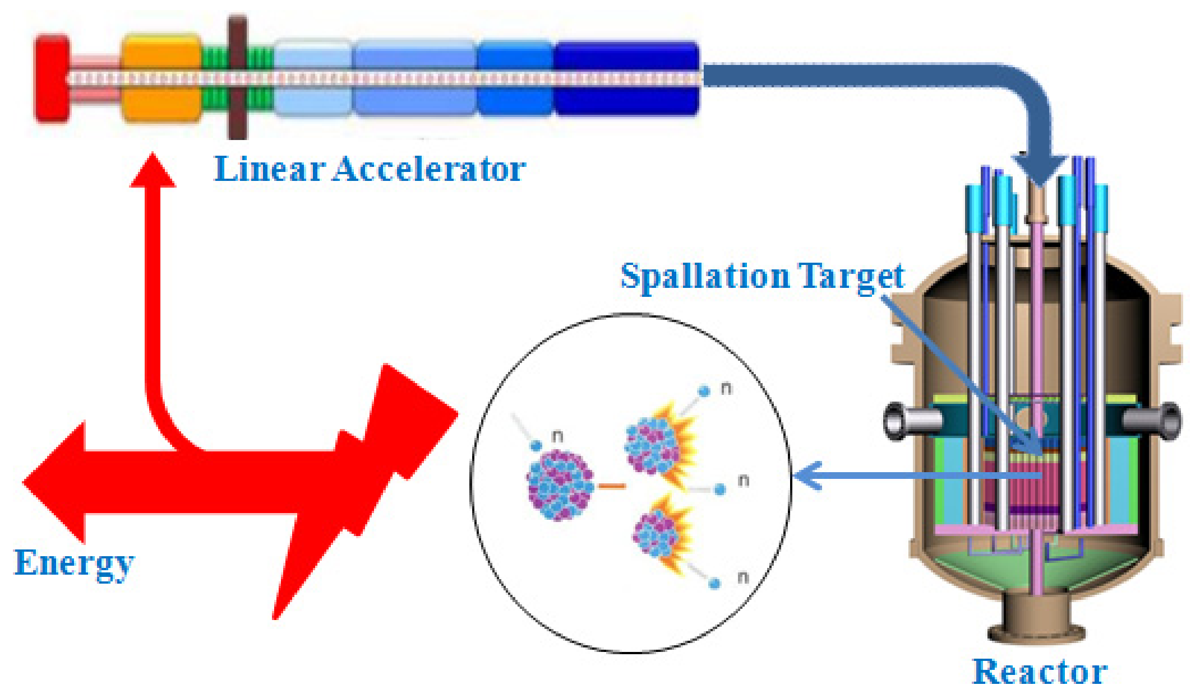
Hope (cont’d)
Accelerator-driven sub-critical systems
Use a particle beam to drive a sub-critical pile of fissionable material into criticality.
Pros:
Beam goes off -> reaction stops (no danger of a melt-down)
Can burn thorium
Can burn non-enriched fuel (no-proliferation danger)
Burns up long-lived waste
Cons:
Difficult and expensive.
This generating a lot of interest in India, which has a LOT of thorium.
Stay tuned…

Slide 46
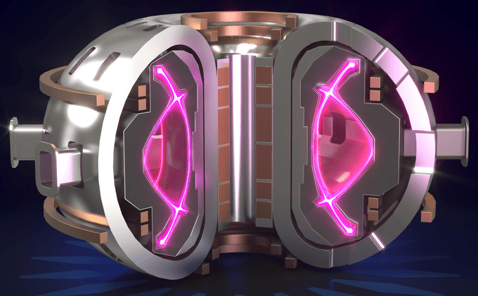
Compact Fusion Reactors?
A number of companies are exploring compact fusion reactors as an alternative to ITER.
Some are straight up scams.
Others are sincere, but (IMHO) overly optimistic.
e.g. Commonwealth Fusion Systems, which spun off from MIT
Time will tell.

Slide 47
Some final comments
This is just the tip of the iceberg
Just go to YouTube and search for
Tom Bearden
Joe Newman
Stan Meyer
Bedini Motor
Or just “free energy”
Watch the videos and read the comments
Perpetual motion is just one facet of our society’s obsession with pseudo-science
Compare the Astrology section of bookstore with the Science section.
We will never solve the daunting (and exciting) energy challenges facing us unless we first face reality.

